Slide 1


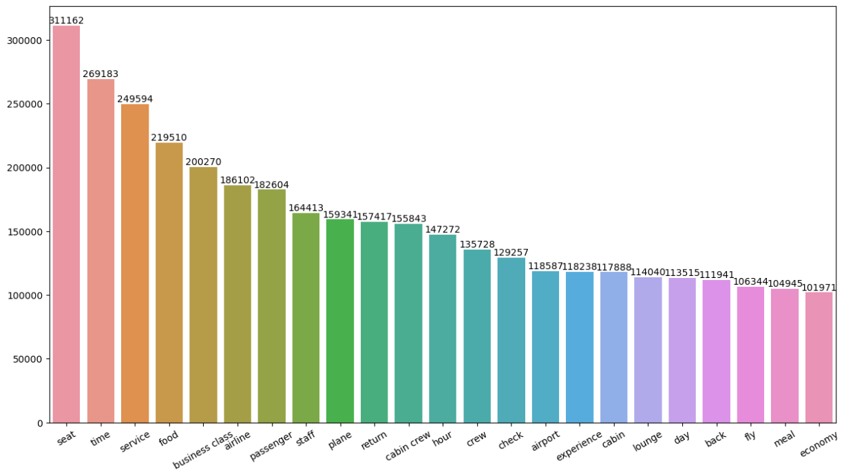

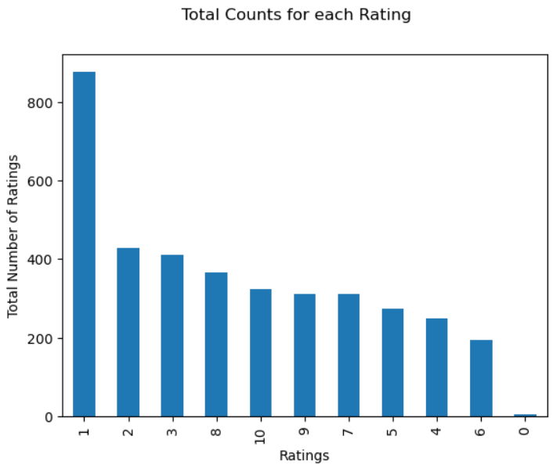
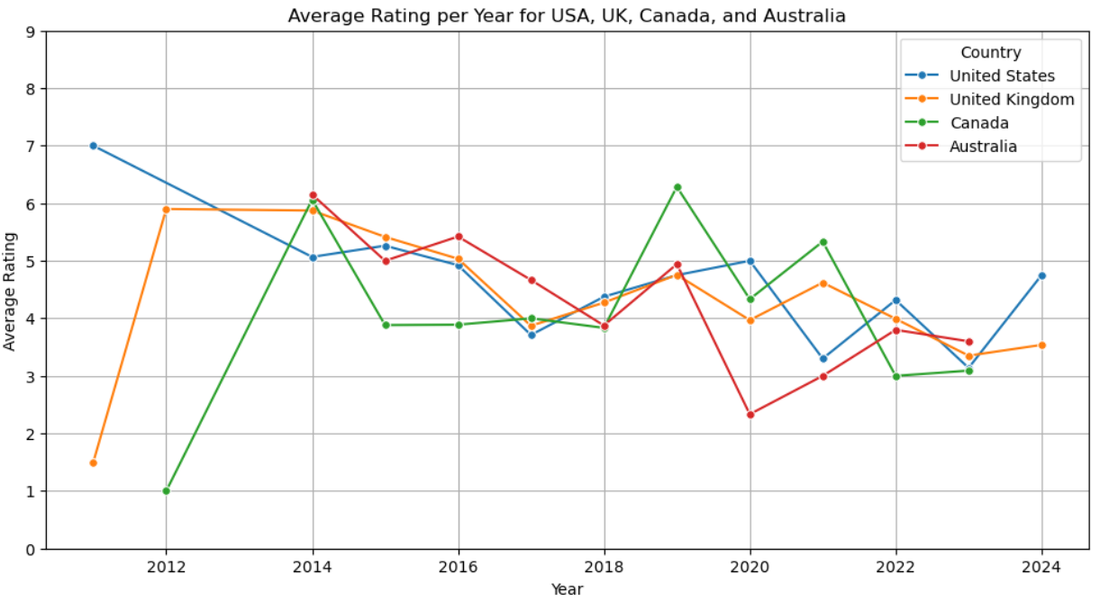
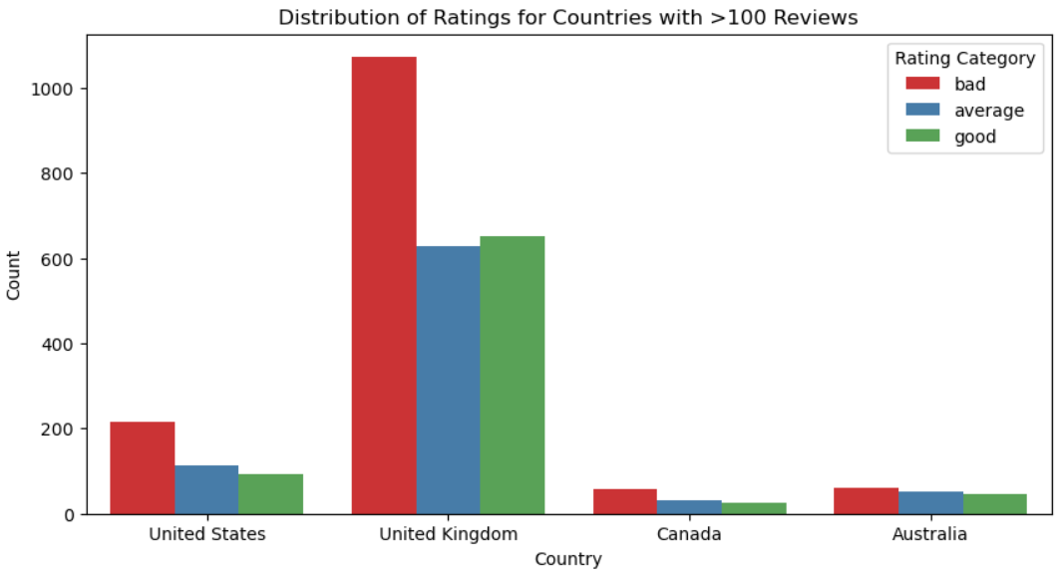
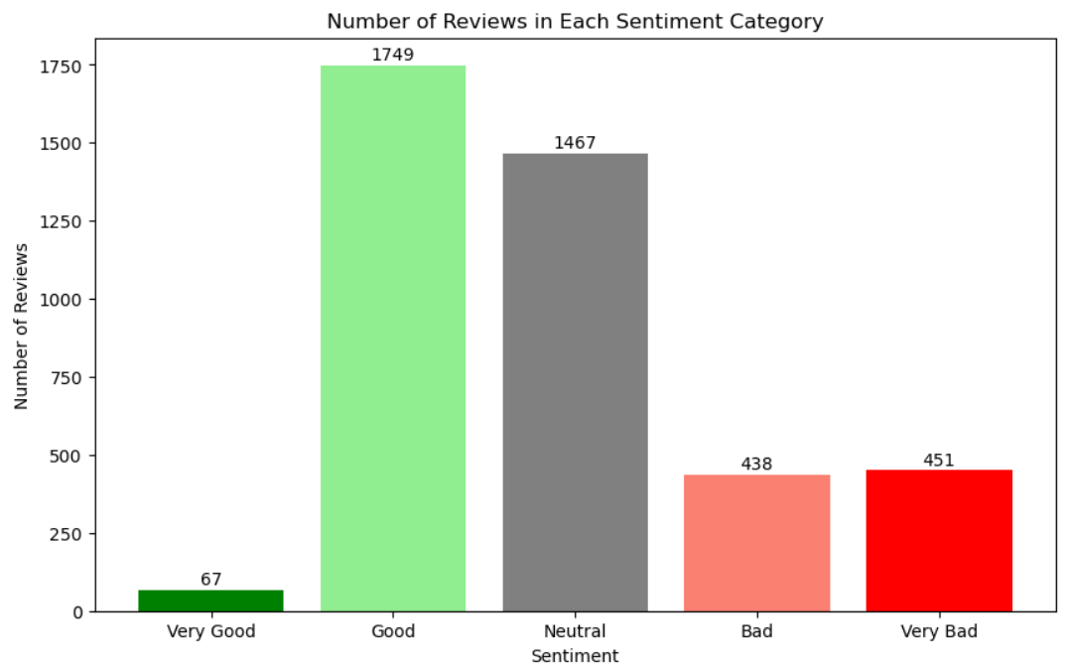
Key metrics: Customer Review Analysis
Total Reviews: 3750
Mean Rating: 4.7
Good (8-10): 26.7 %
Okay (4-7): 27.5 %
Bad (1-3): 45.8 %

